Slide 2
Module 8: MS SQL Day 1

Slide 3
Agenda XX.XX.2022
from | to | topic
9:00 | 9:15 | Introduction
9:15 | 12:30 | Self Study Block
~10:30 | ~10:45 | Coffee break
12:00 | 12:30 | Discussion Block: Self Study Session
12:30 | ~13:00 | Lunch Break
13:00 | 13:30 | Content Questions
13:30 | 16:00 | Excecise Block
16:00 | 17:00 | Discussion Block : Excercise

Slide 4
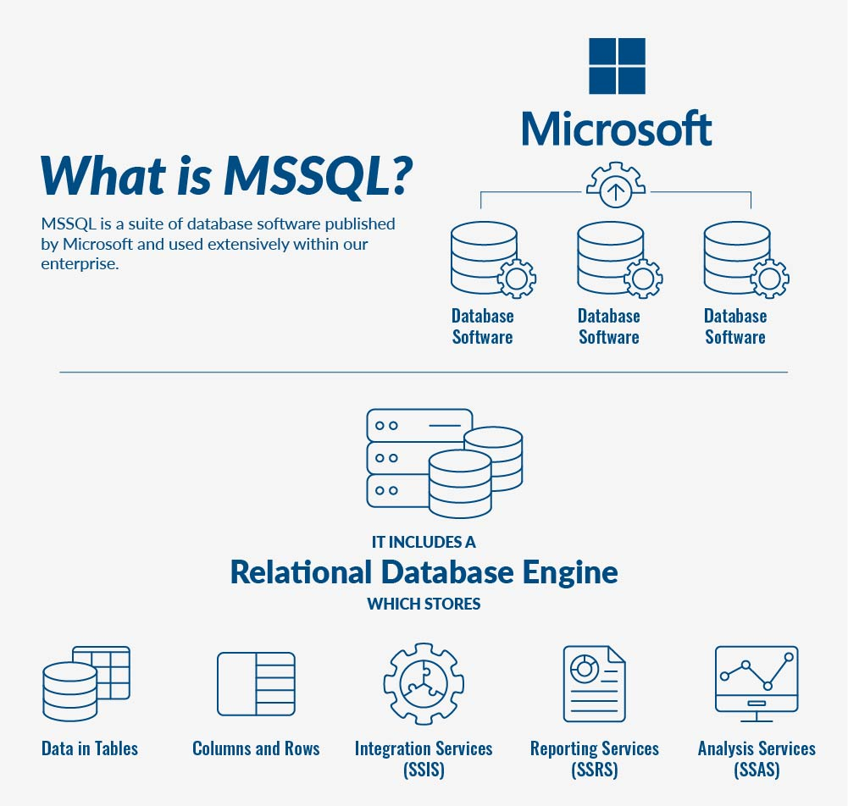
What is MS SQL?
MSSQL is a suite of database software published by Microsoft and used extensively within our enterprise. Typically, it includes a relational database engine, which stores data in tables, columns and rows, Integration Services (SSIS), which is a data movement tool for importing, exporting and transforming data, Reporting Services (SSRS), which is used to create reports and serve reports to end users, and also Analysis Services (SSAS), which is a multidimensional database used to query data from the main database engine.

Slide 5
Material
Go through the below training material:
https://www.sqlservertutorial.net/getting-started/
https://www.sqlservertutorial.net/sql-server-basics/

Slide 6
Questions
Answer the below questions:
What is the difference between SQL and MS SQL?
What are the common performance issues in SQL Server?
What are the authentication modes in SQL Server? How can it be changed?
What is CDC in SQL Server?
What is a Cross join and how is it different from other joins in MS SQL?
What do you understand by CHECK constraint in SQL Server?
What do you understand by CTE?
What is COALESCE in SQL server and mention its few properties?

Slide 7
Good luck!
Dein yakha Team

